Slide 1
Enterprise Product Strategy
Robin Murray
Members’ Council
May 2007

Slide 2
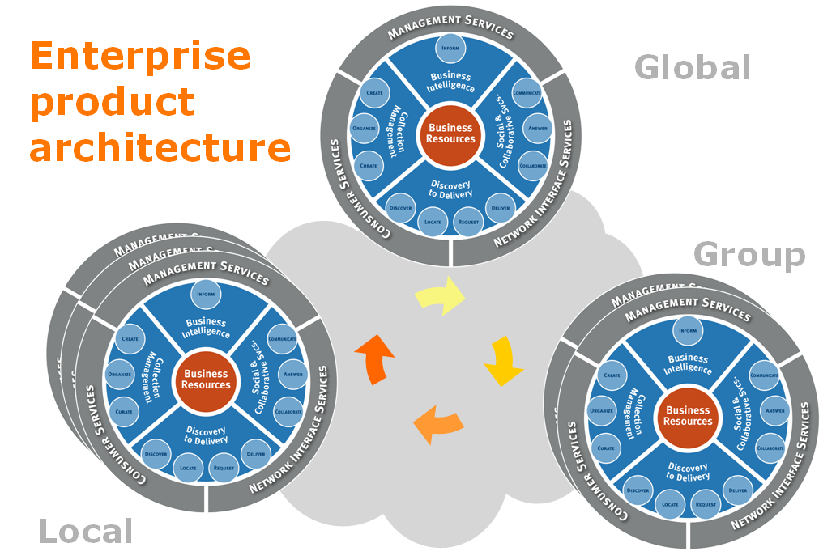
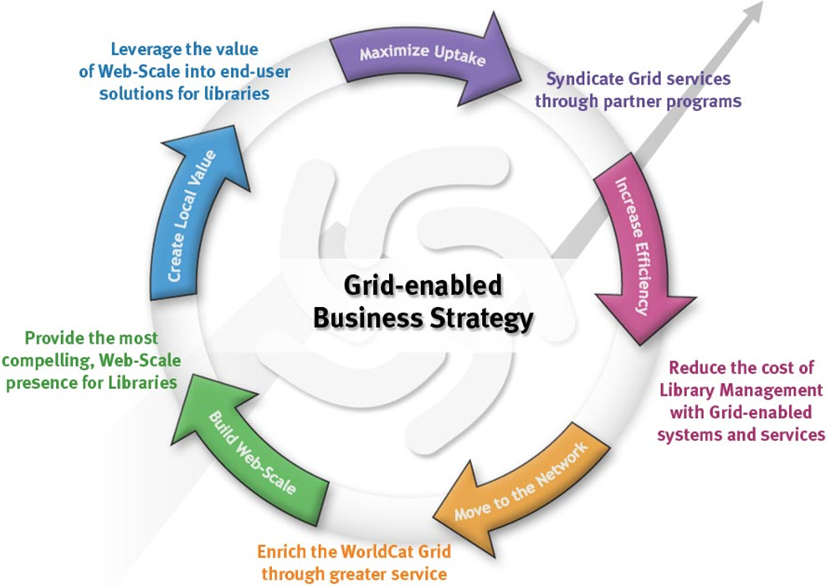
Overview – From Strategy to Execution…
The enterprise product architecture
  How we are organized to deliver
The ‘fly-wheel’ business strategy
  Concrete product initiatives against the fly-wheel
Rollout
  Global issues

Slide 3
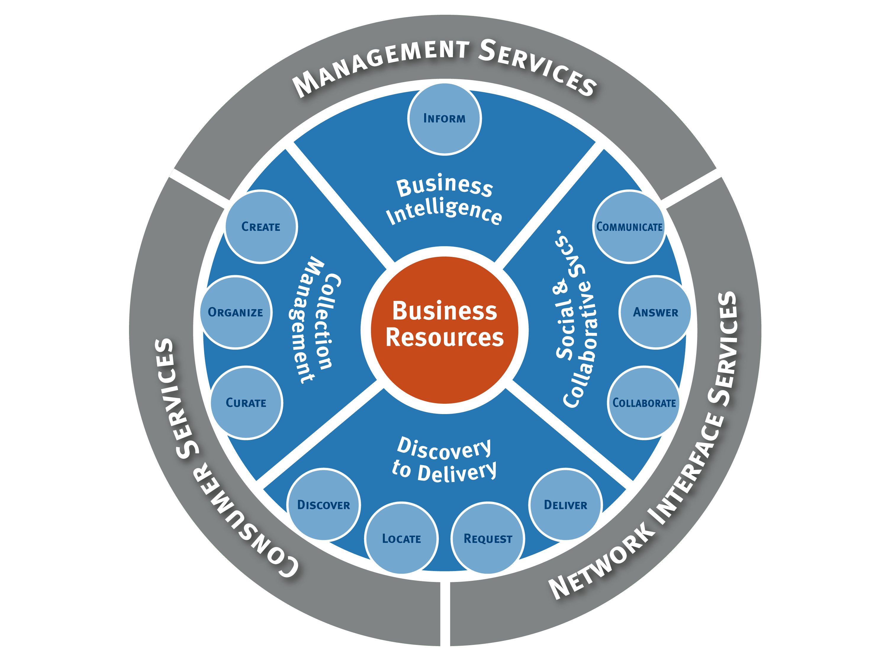
Enterprise
product
architecture
Global
Group
WorldCat
Grid
Local

Slide 4
Enterprise Product Architecture
The specific product lines which provide access to services and automate business processes.
Product Lines
The network interfaces &
common components that
share services across
nodes and product lines
Grid Services
Content & Metadata Services
The content &
Metadata that underpins
all our services

Slide 5
Enterprise Product Architecture : Organizing to deliver…
3rd Party
Content
Portfolio
End-user
Environment
Portfolio
Delivery Portfolio
Management
Systems Portfolio
Digital
Repository Portfolio
Grid
Services Portfolio
Metadata
Services Portfolio
3rd Party Content
End User
Environment
Delivery
Management
Systems
Digital Repository
WCRS
VDX
1CATE
ILL`IIAD
…
ILS/Circulation
Union Cat
ERM
Business Intel.
QuestionPoint
WorldCat.org
EU Platform
Portals…
Picarta
Social Stuff
NetLibrary
FirstSearch
CONTENTdm
Grid Services
Data utilities Network services
Standards Common Components
Developer Network Registry Infrastructure
Content & Metadata Services
WorldCat Cataloguing…
Registry Content
Batch Loading Data Expertise…

Slide 6
Network level
OCLC’s unique strategic advantage is the ability to deliver local, group, and global solutions that simultaneously leverage the value of the network, and add value to the network.
Web-scale

Slide 7
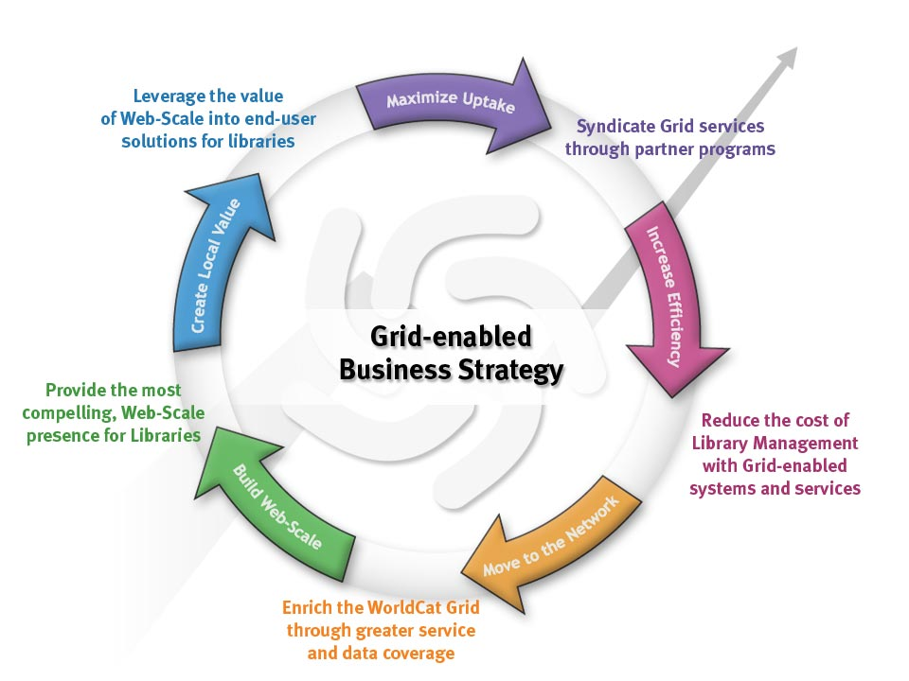

Slide 13
Provide the most compelling Web-Scale presence for libraries
WorldCat.org : Focus on what users do…
  Keep it simple…
Add social networking features
  Reviews & rating improvements
  Personal lists, recommendations
  Tagging
  Build community
Add features
  WorldCat Identities
Search Engine Optimization
  Maximize efficiency of Search-engine access
  URL structures
  Motivate linking
Every library should realize they NEED to be represented on worldcat.org
FY 08 initiatives
Build Web Scale

Slide 14
Leverage the value of Web-Scale into end-user solutions for Libraries
Leverage the value of Web-Scale into end-user solutions for Libraries
Discovery
  Launch and widely deploy WorldCat Local
  Add features
    Article metadata…
    Delivery options…
Delivery
  Worldcat.org / Local as the entry point
  Comprehensive & intelligent delivery options
    Electronic resource resolution
    Consortial borrowing
    Buy-it
  Home delivery – from pilot to product
FY 08 initiatives
Create Local Value

Slide 15
Syndicate Grid services through partner programs
Syndicate Grid services through partner programs
Make data work harder
  xISBN, Audience-level,…
Integration components
  ILS Service integration
  Authentication / identity management…
Build community
  Developer network
Making it easier to participate & build web-scale
FY 08 initiatives
Maximize Uptake

Slide 16
Reduce the cost of library management through Grid-enabled systems & services
Cataloging
  Move record capture upstream
  Radically improve batch-load
Digital Repository
  Link local, group and global nodes
  Integrate physical and digital metadata
Electronic Resource Management
  Investigate potential for network-based ERM
Physical Repository
  Investigate potential for network-based circulation/acquisitions
FY 08 initiatives
Increase Efficiency

Slide 17
Enrich the WorldCat Grid through greater data & service coverage
Greater data acquisition
  Increase participation
  Add local data with global significance
New data types
  Registries…
  Make the network work
New services
  Identifiers
  Payment
  …
FY 08 initiatives
Move to the Network

Slide 18
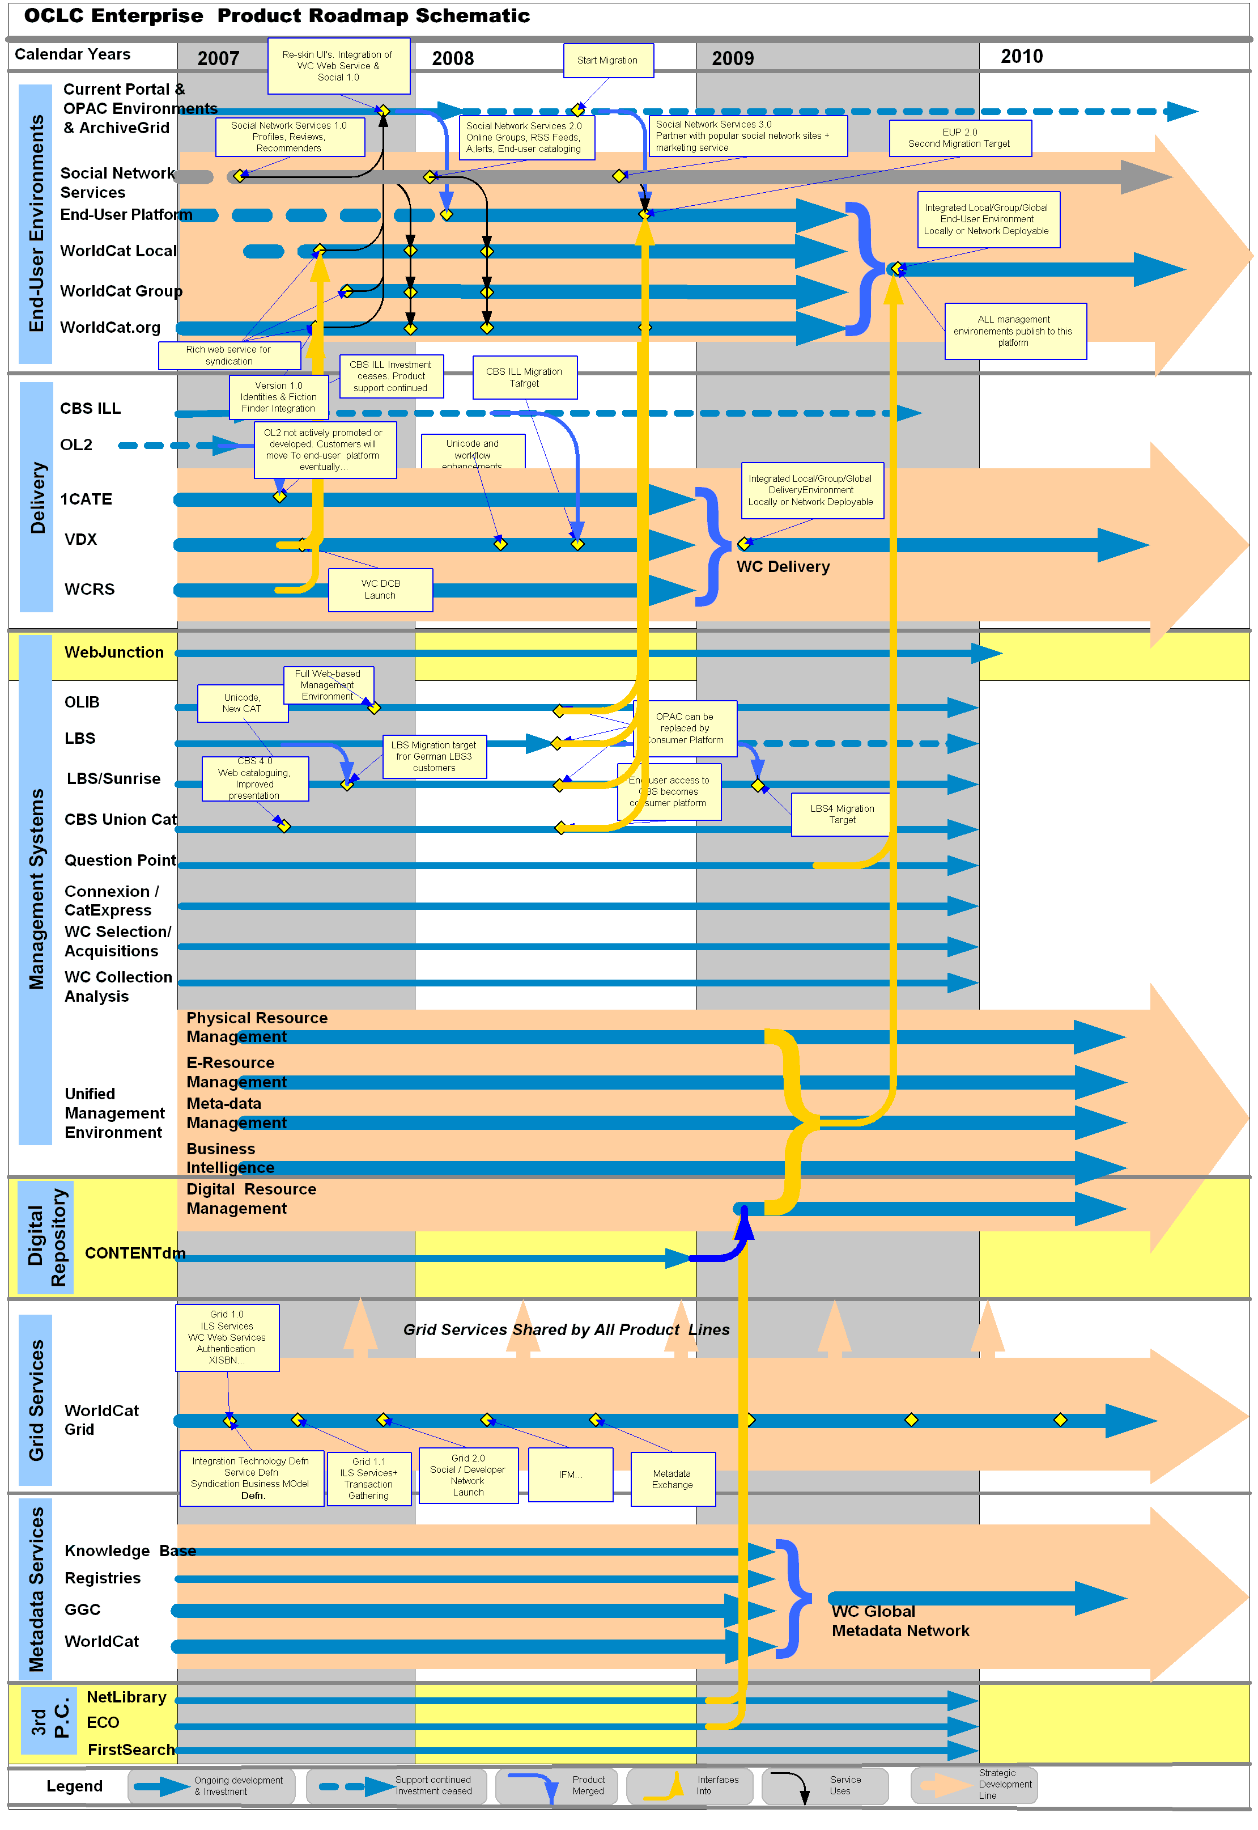
Enterprise Product Roadmap
Development Schedule
Principles
Move products into the ‘strategic flow’
Spin the fly-wheel

Slide 19
Delivering Web-scale…
…Globally

Slide 20


EMEA
e
Americas
Asia Pacific
e
e
WorldCat-based products
Centralized services
e
Although the relative size of symbols may not be an exact representation, the image visually represents the differences between markets in OCLC product heritage
eContent/digital content
NL, FS, PiCarta, ECO, etc.
Local systems and institution-focused products

Slide 21
Americas
BUILDING WEB SCALE
Incrementally delivering
local & group systems
framework around
our content & services
e
EMEA
BUILDING WEB SCALE
Incrementally delivering
our content & services into
our local & group systems
Grid: Content-enabled
Systems & Services
e
e
APAC
BUILDING WEB SCALE
Integrating activity into a
coherent strategy that
delivers web-scale,
content-enabled
systems & services
e

Slide 23
Enterprise Product Strategy
Robin Murray
Members’ Council
May 2007

